Slide 1

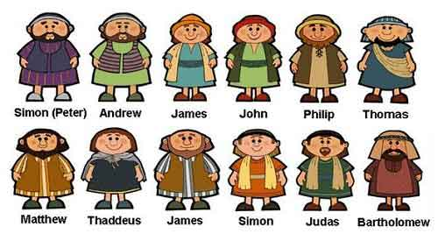
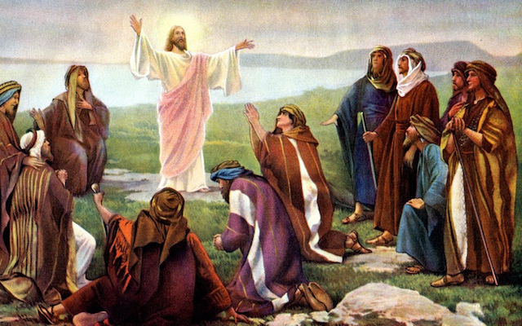
Gospel
What is the Good News Jesus Brings?

Slide 2
Let’s see if we can start to answer our “Big Question”:
What is the Good News Jesus brings?
Christians believe that Jesus brings forgiveness and friendship.
Christians believe Jesus brings good news for all people. This good news includes being loved by God, and being forgiven for bad things.
Christians believe God can bring peace.

Slide 3
This week we are going to investigate the Church building.
Why do Christians go to Church?
Think about the “Good News” Jesus brings to help you.

Slide 4
Did you come up with any of these ideas?
To feel part of a community
To be friendly
To be able to forgive others
To find peace
To be forgiven

Slide 5
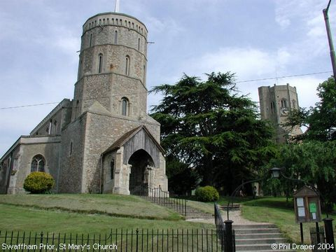
Where would Christians find peace within the Church?
Let us look at different places in the church for ideas.

Slide 6
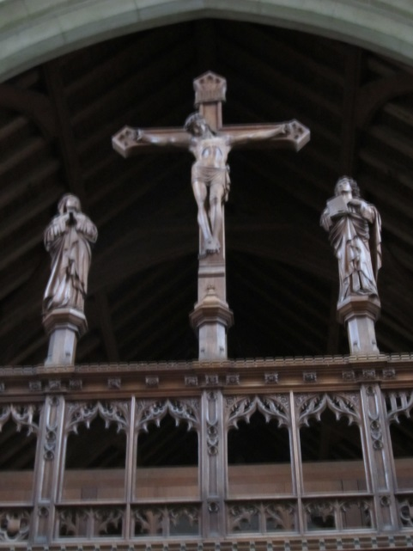
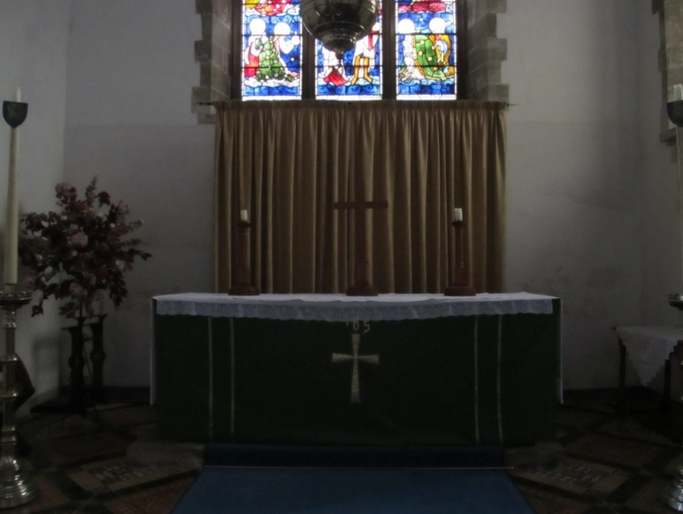
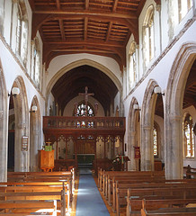
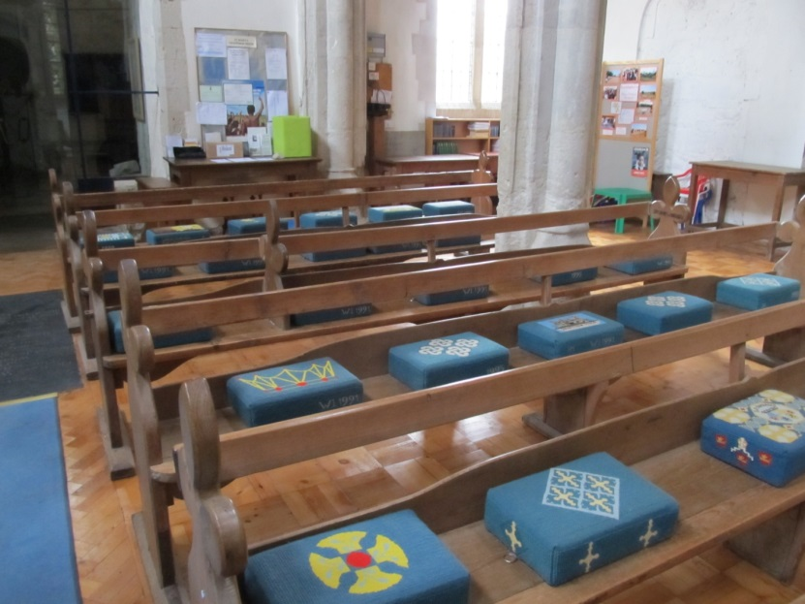
Where do you think a good place would be to find peace?

Slide 7
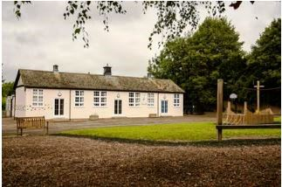
Let’s think about our school;
Where do you think the friendliest place is?
Is there a place that might help you to forgive?
Is there a peaceful place?

Slide 8
L.O. To understand the meaning of ‘peace’.
Draw a picture of a peaceful place.
If you wanted peace, where would you go? Maybe you would go to somewhere in your garden, or a place in your home.
Then, write about your peaceful place.
I have written about my peaceful place:
My peaceful place is the summerhouse in my garden. I like to go there because it is quiet and I can watch the birds eating on the bird table. My dogs also come and sit with me and keep me company. I feel relaxed and calm there.

