Slide 1
https://www.loom.com/share/a7b21f8b593d4c229966fbb03e0765c3

Slide 2
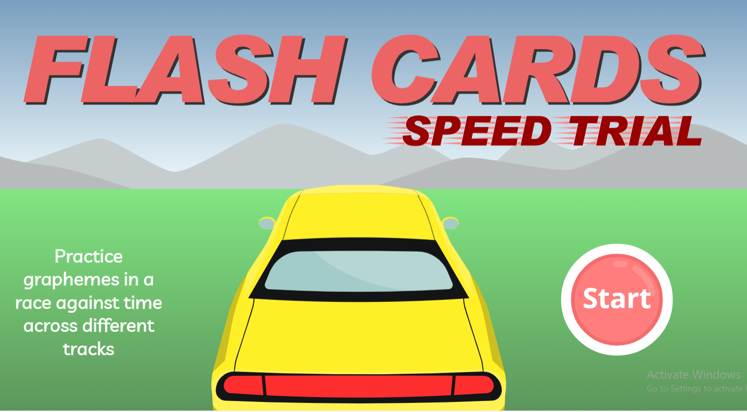
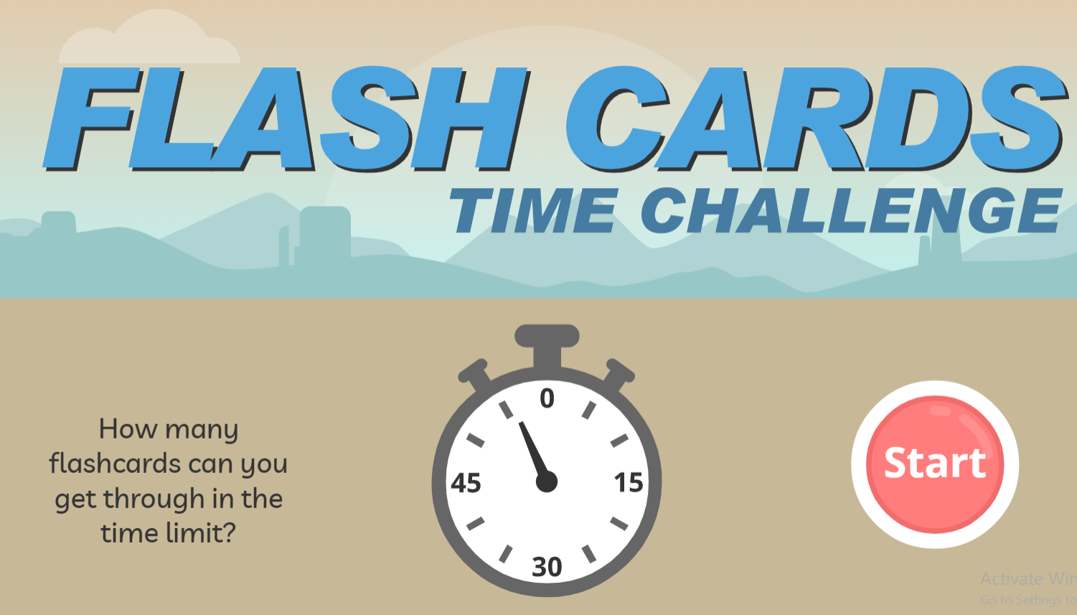

Review 3 phonemes
Click an image below to open the Phonics Play website. Log in and select phase 3
Log in details:
www.phonicsplay.co.uk
Username: Swaffpri
Password: phonics

Slide 3
Practise Blending CVC words- oral
pot
win
yet
hen
vet
bag
pop
cap
bin

Slide 4
Practise Blending CVCC- oral
desk
bond
rust
gulp
went
skip
gong
junk
trim

Slide 5
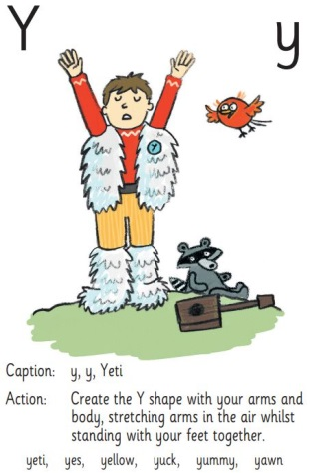
Practise Blending Words – y
yap
yum
yell
yet
yes
yuck
yeti

Slide 6
Practise Blending Words
yet
yap

Slide 7
Practise Blending Words
yeti
yum

Slide 8
Practise Blending Words
yes
yuck

Slide 9


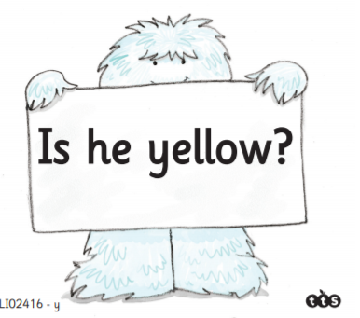

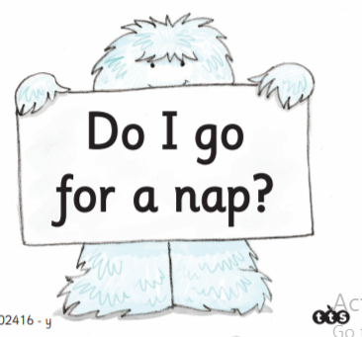
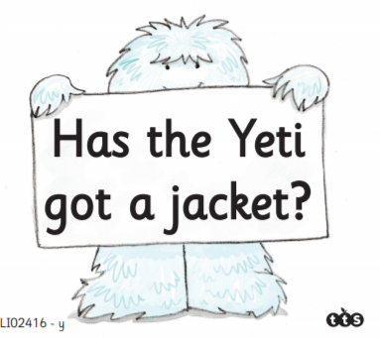
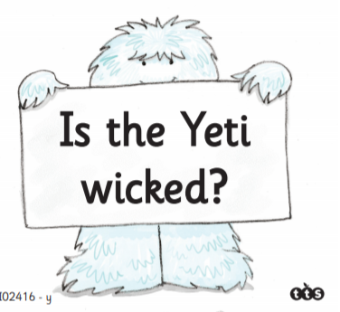
Apply – Read the question. If the answer is yes make a y shape with your arms. If the answer is no hold up a card saying no.

Slide 10

Story Time Phonics
Click on the ‘caption action’ image to link to the website. Log in and listen to the story
Log in details:
http://ttsstorytimephonics.co.uk
Username: SwaffhamPriorCEPrimarySchool
Password: SwaffhamPhonics2020

